Slide 1
ECE 5397/6397:
Introduction to Robotics
Lecture 11:
so(3) and the derivative of a rotation matrix, velocity of a point attached to a moving frame, addition of angular velocities
Reference: Chapter 4.4-4.6, RD&C
Instructor: Aaron Becker

Slide 2
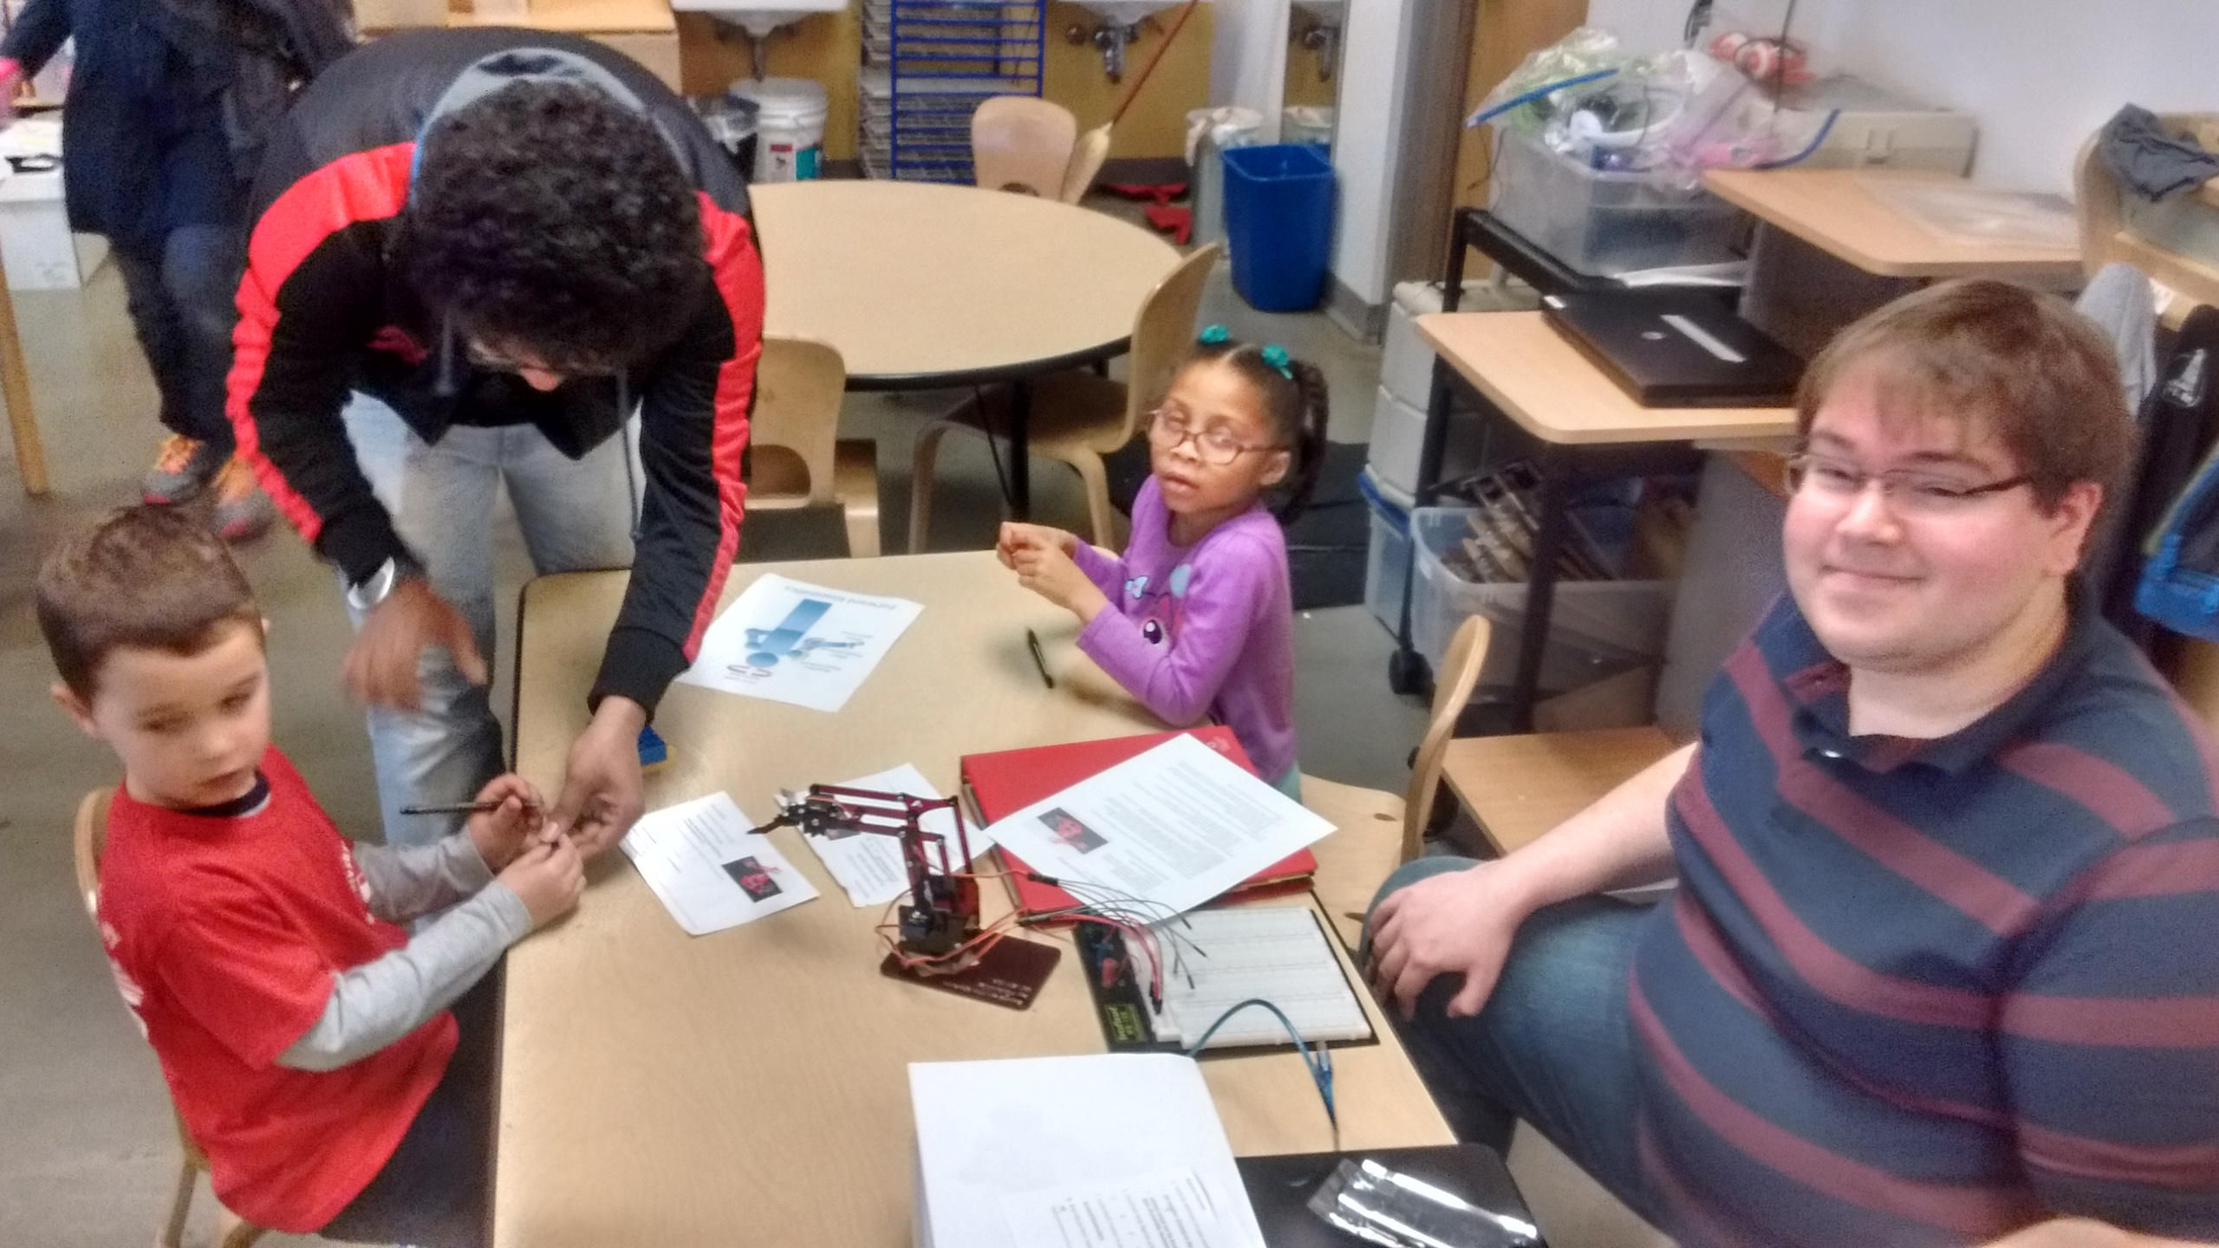
Welcome!
We had an outreach! Thank you!

Slide 3

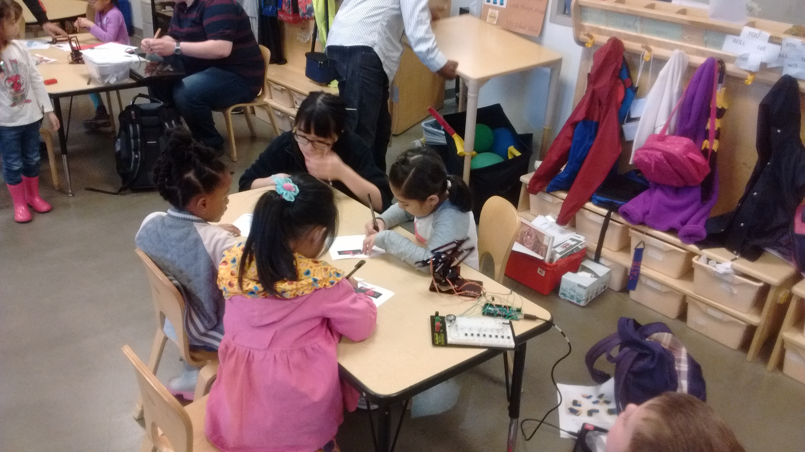
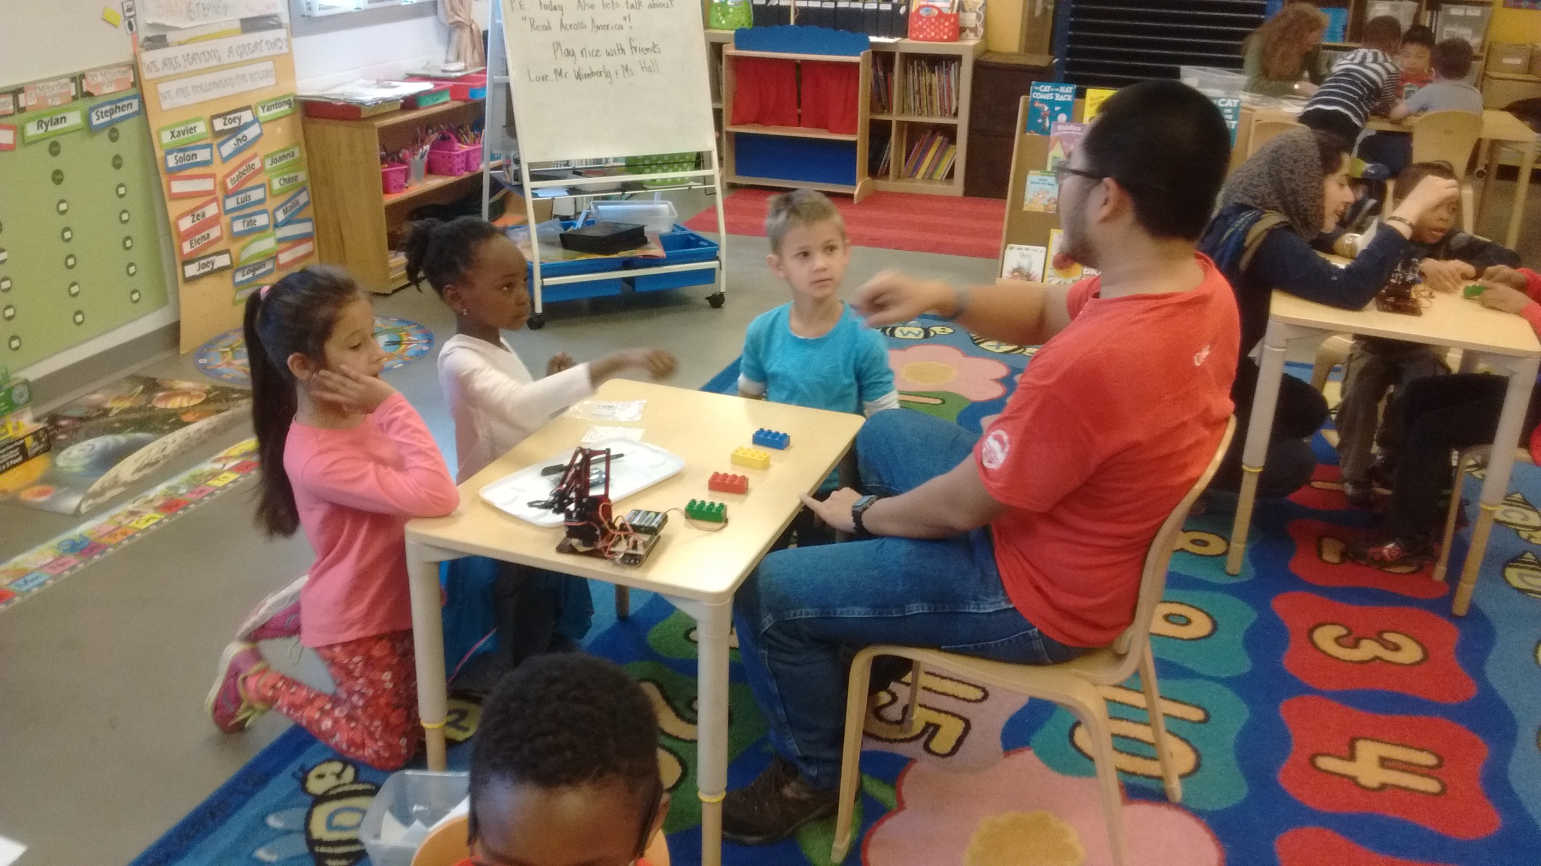


Slide 4
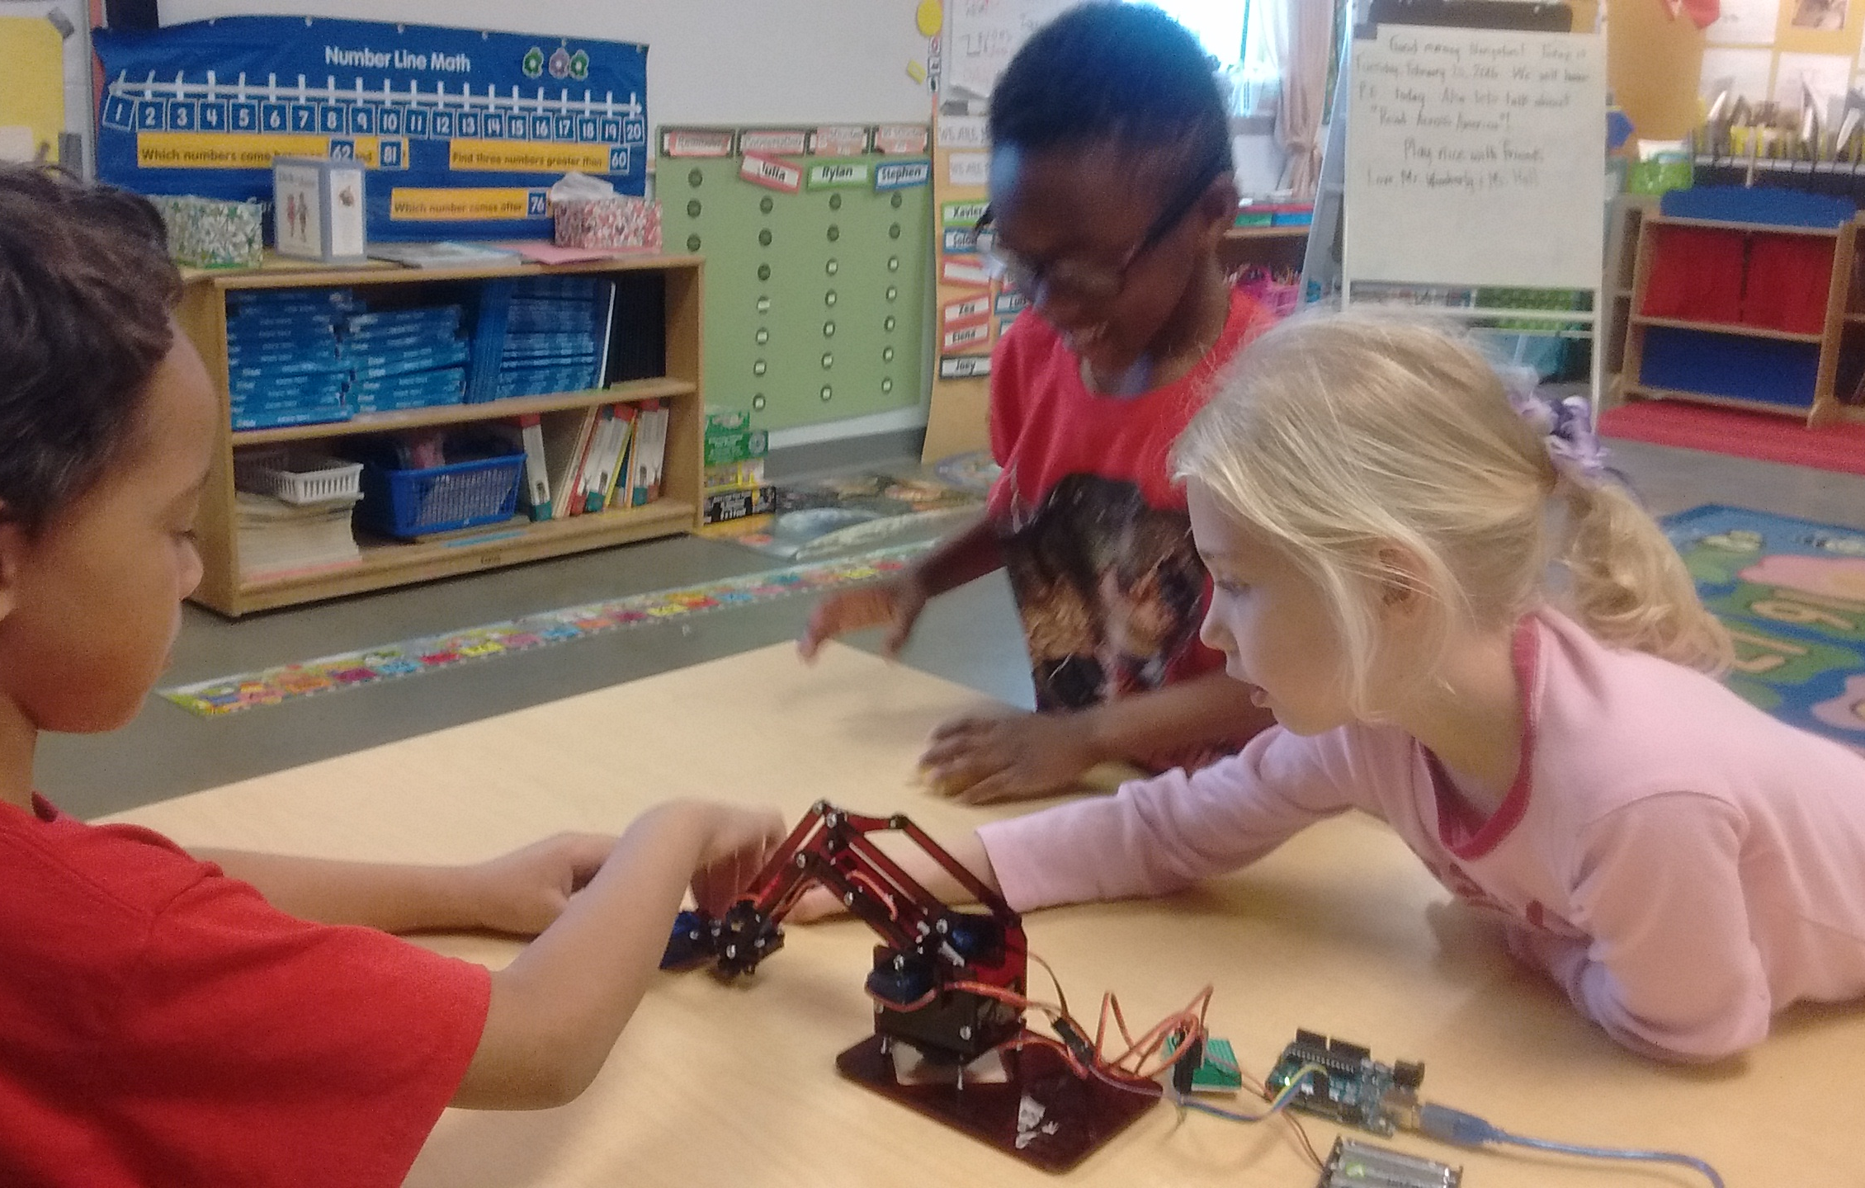

Slide 5
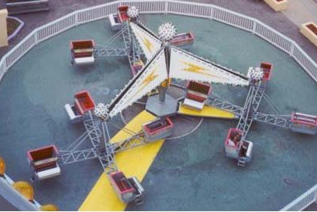
What is the angular and linear velocity here?

Slide 6
What is the angular and linear velocity here?
q₁, d/dt q₁
q₂, d/dt q₂

Slide 7
The Jacobian maps joint velocities to end-effector linear and angular velocities

Slide 8
Review material
Notes:
Matrix rep of S(a) in a coordinate frame rotated by R is the same as the skew symmetric matrix S(Ra) corresponding to the vector a rotated by R

Slide 9
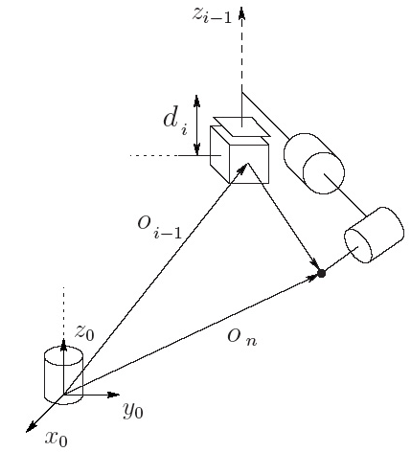
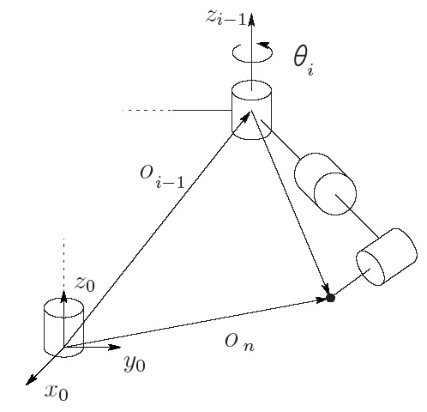
Goal: define Jacobian
Notes:
Procedure also works for defining the velocity of any point on the manipulator. Cool!

Slide 10
Goal: prismatic Jacobian
Notes:
Procedure also works for defining the velocity of any point on the manipulator. Cool!

Slide 11
Goal: revolute Jacobian
Notes:
Procedure also works for defining the velocity of any point on the manipulator. Cool!

Slide 12
For the Next Class
Study Ch 7 A Gentle Introduction to ROS for Lecture 12

Slide 13
In class worksheet

